Slide 1
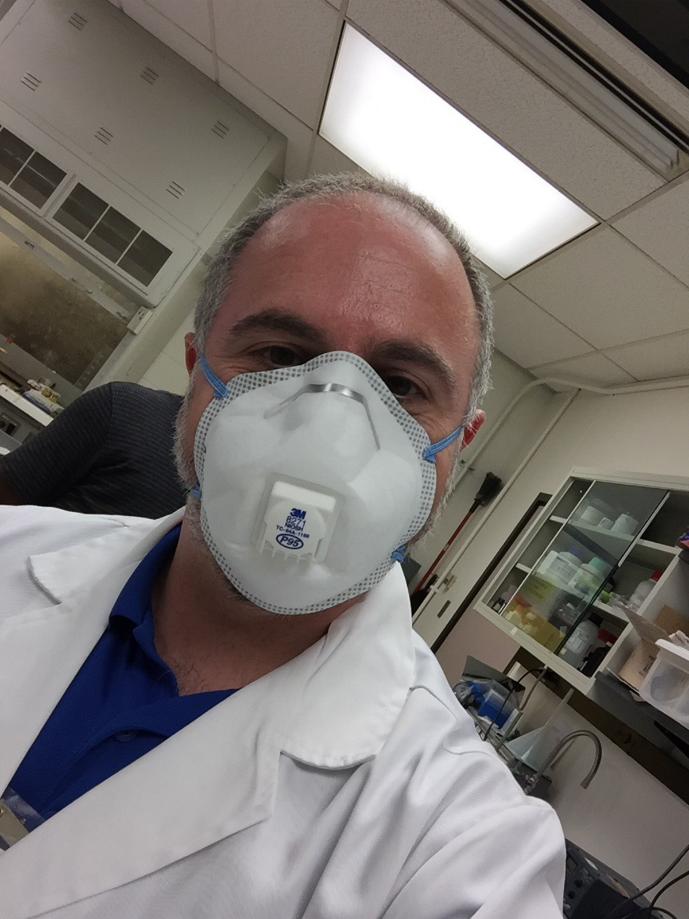
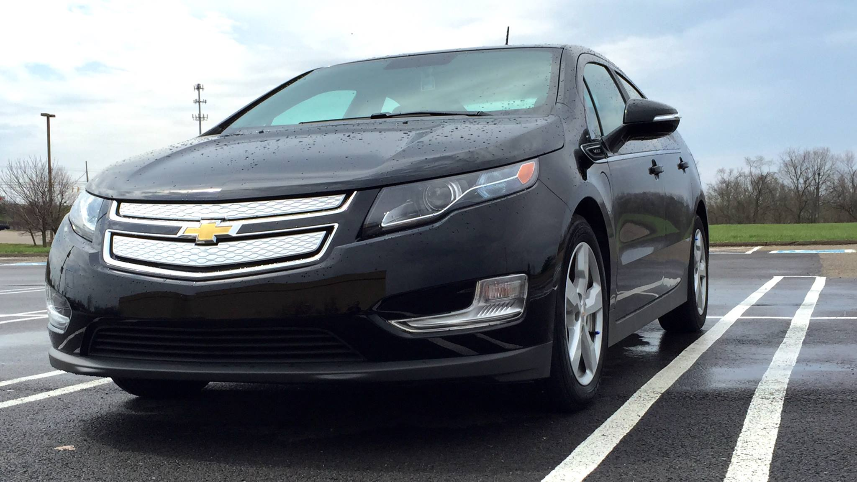
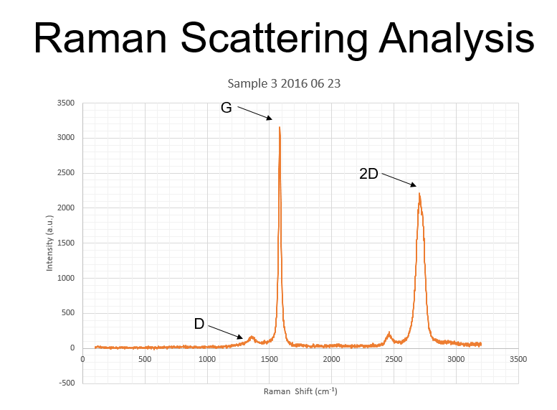
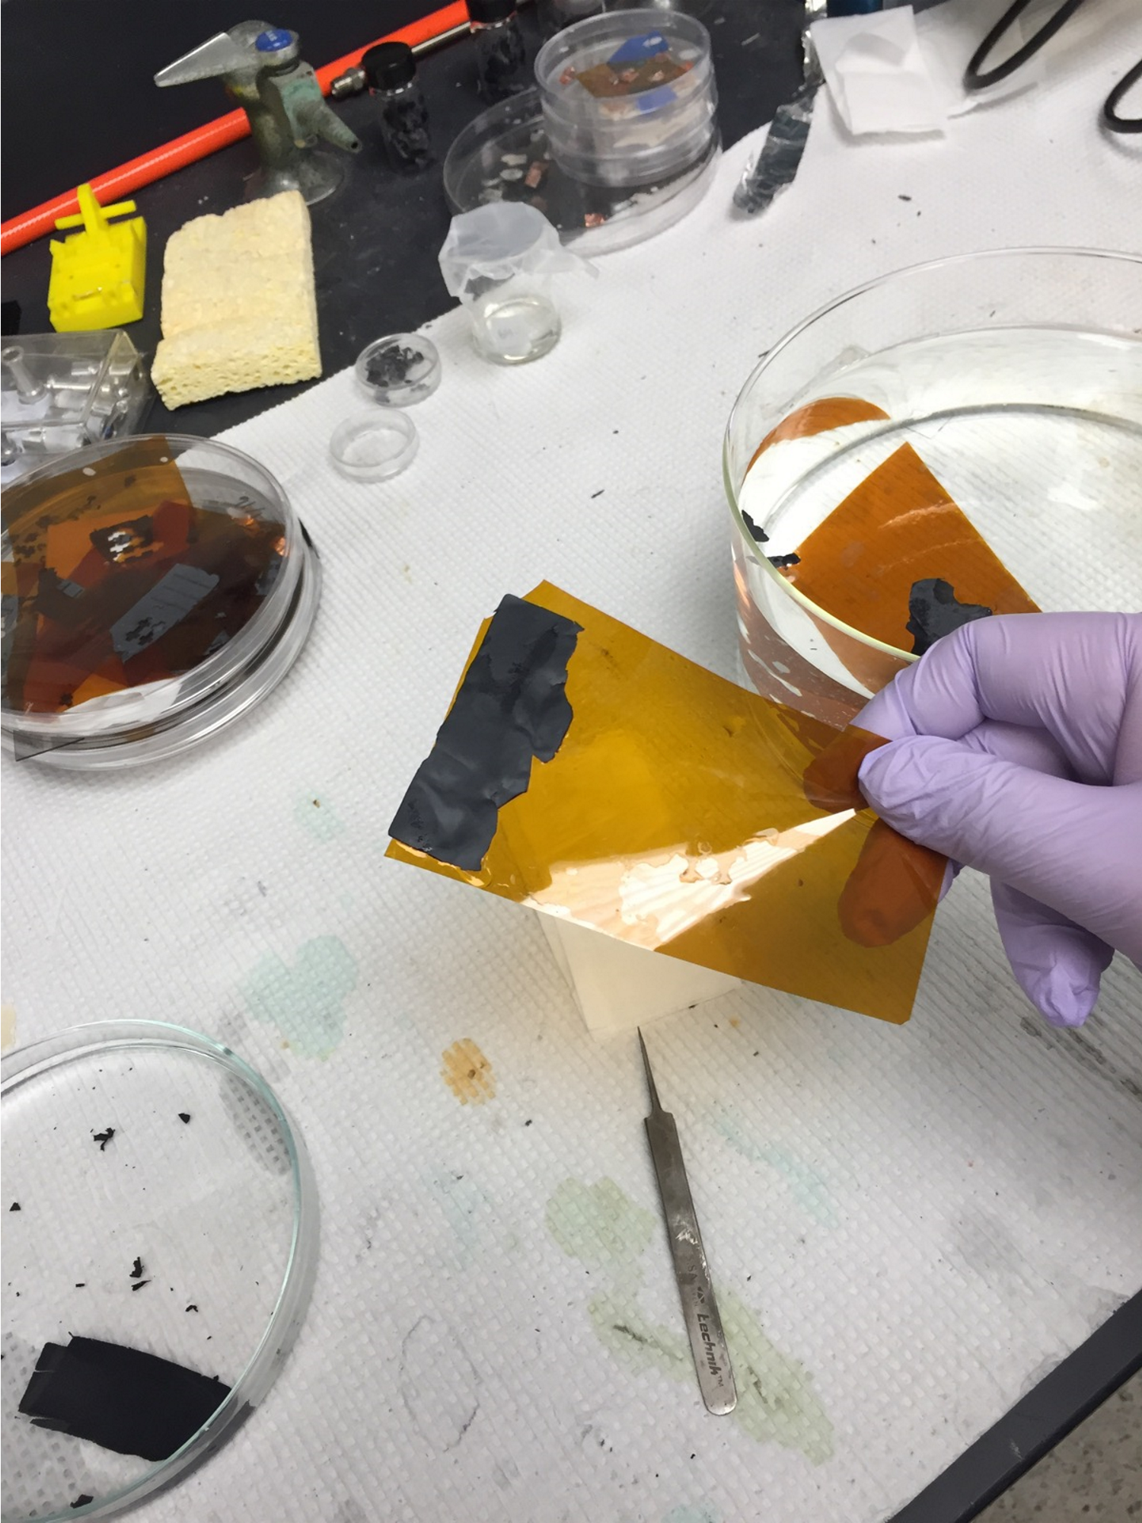
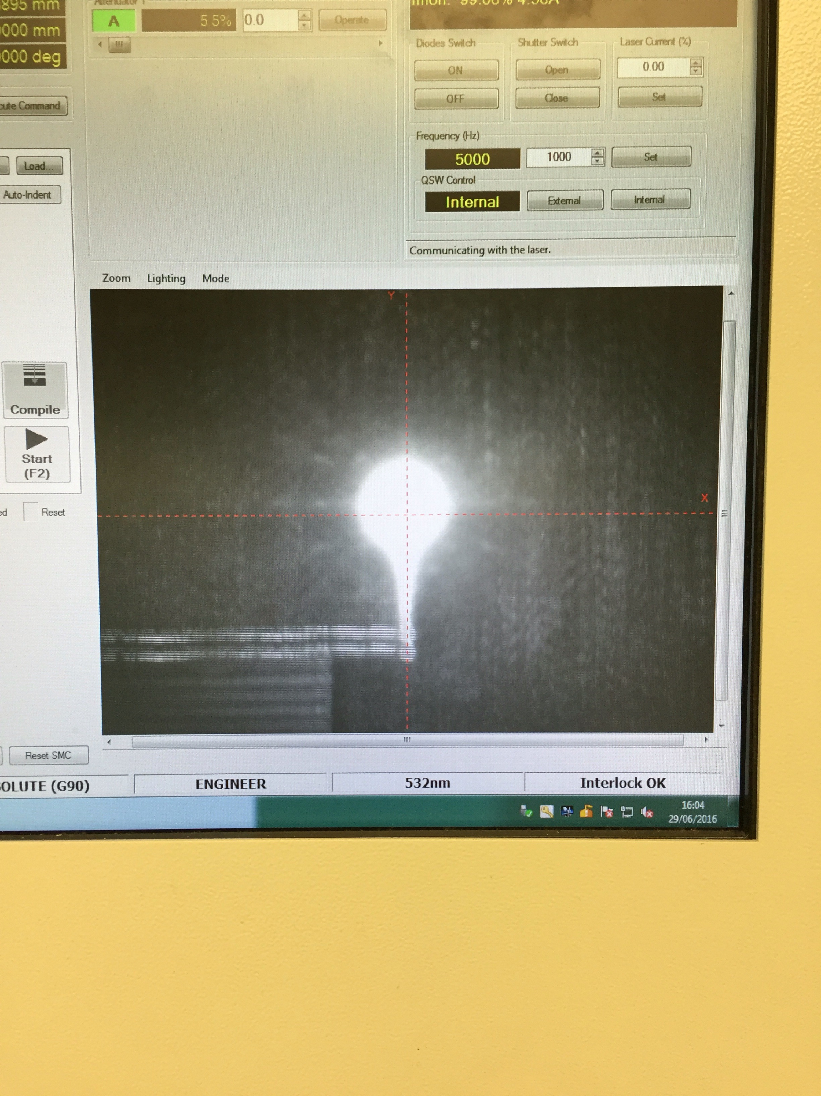
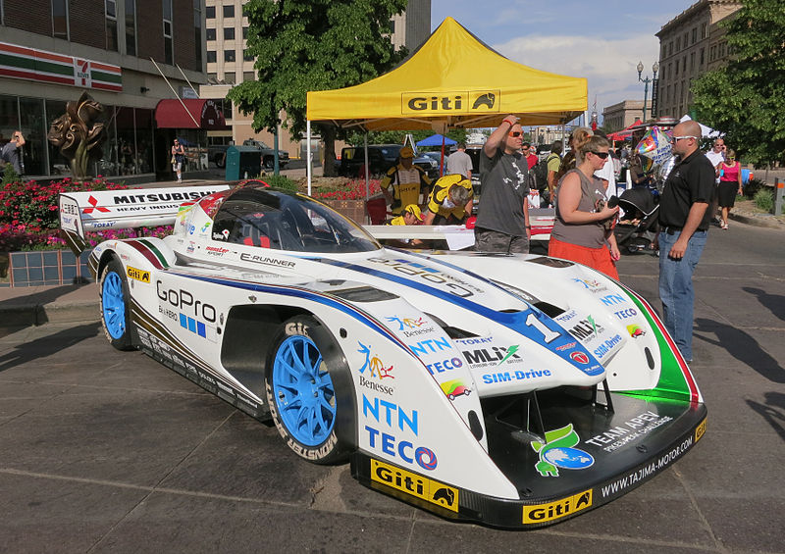
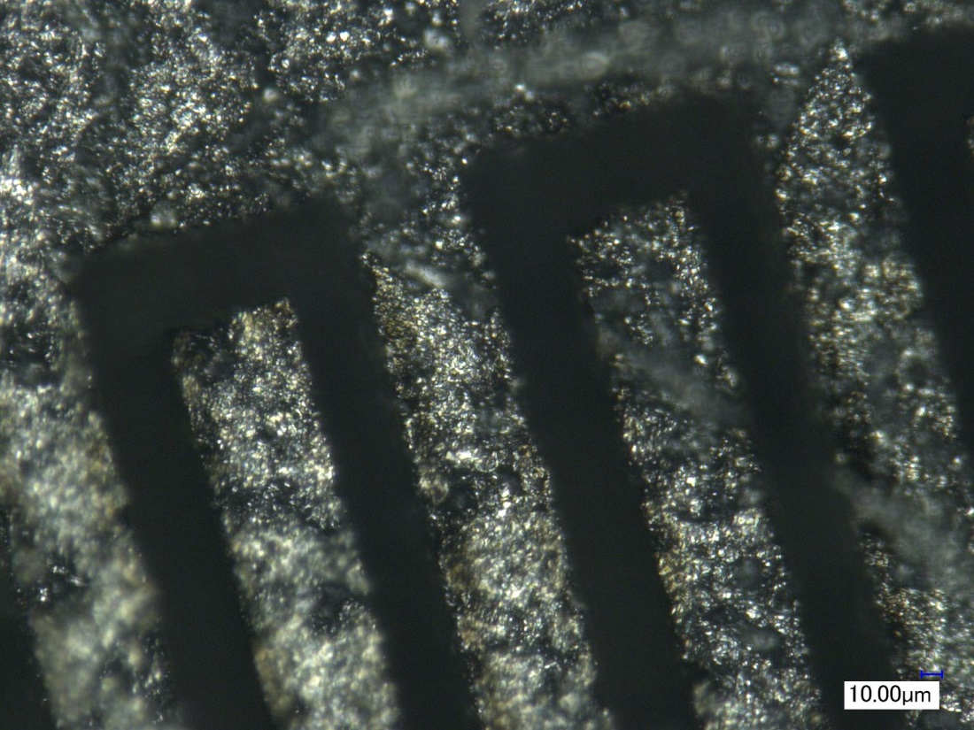
Electric Power and Energy Usage John J. D’Alessandro St. Xavier High School, Physics
RET is funded by the National Science Foundation, grant # EEC-1404766
Summer Research:
Synthesis Characterization of
Graphene for Energy Storage Devices
Challenge-Based Learning
(CBL)
Big Idea
Engaging
Multidisciplinary
Real-world Problem-solving
Collaborative
Hands-on
Connected to Experts
Connected to Community
Deepens Subject Knowledge
Climate Change Is Partially Due To Our Use Of Fossil Fuels
Other Sources Of Energy And That Will Require Storing It For Use.
Goals
Synthesize Graphene Papers
Build Supercapacitors
Analyze Supercapacitor Quality
Hook
Figure 1. About to Work with
Nickel Powder and Polymer
Process
Make Nickel-polymer Slurry
Use Chemical Vapor Deposition to Form Graphene
http://www.challengebasedlearning.org
Figure 2. Raman Spectroscopy Analysis of Graphene on Nickel Substrate
Engineering Design Process
(EDP)
Clean Graphene
Characterize Graphene
Plug-in Electric and Hybrid Cars Have Different Energy and Power Characteristics Than Conventional Gasoline Vehicles
Figure 3. Mounting Graphene Paper on Kapton Film
Design and Mill
Interdigital Patterns on Graphene Paper
Coat with Electrolyte
Identify and Define
Gather Information
Identify Alternatives
Refine
Communicate
Select Solutions
Figure 4. Laser Etching Interdigital Pattern on Graphene Paper
Mount Conducting Wire
Characterize Supercapacitor
Try More Designs!
Communicate Solution
Evaluate Solution
Implement Solution
Figure 5. Graphene Paper Digits on Kapton Film
Monster Tajima Electric Car, June 2013, Photographer: Furyanto

